Slide 1
RPC is Evil
Prefer Messaging

Slide 2
Who are you?
Software Developer for 20 years
Worked mainly for ISVs
Reuters, SunGard, Misys, Huddle
Worked for a couple of MIS departments
DTI, Beazley
Microsoft MVP for C#
Interested in OO, SOA, EDA,, Messaging, REST
Interested in Agile methodologies and practices
No smart guys
Just the guys in this room

Slide 3

Intelligent collaboration for the Enterprise

Slide 4
Agenda
What is RPC?
Make a Good Cup of Tea
Nobody Home
Rage Against the Machine
Do You Speak My Language
Toxicity
Message in a Bottle

Slide 5
Housekeeping
Shout if you can’t read the codes of the slides
Don’t worry about the screenshots of white papers, you are not supposed to read the text, it’s just wallpaper.
For simplicity, you can download the slides from
https://github.com/iancooper/Presentations
https://github.com/iancooper/Presentations/blob/master/RPC%20is%20Evil.pptx
Which may help if you are at the back of the room.
Take a photo of this page!

Slide 6
RPC
What do we mean when we talk about RPC?

Slide 7
“In distributed computing, a remote procedure call (RPC) is when a computer program causes a procedure (subroutine) to execute in another address space (commonly on another computer on a shared network), which is coded as if it were a normal (local) procedure call, without the programmer explicitly coding the details for the remote interaction.
That is, the programmer writes essentially the same code whether the subroutine is local to the executing program, or remote.”
Wikipedia
Notes:
When I have two processes, and I want to do interprocess communication, our preferred approach is to use the paradigm of the procedure call and simply do a procedure call that I make locally but executes remotely. This looks to the developers like the stack-based call they are used to, but via a runtime is actually a call to a remote server.

Slide 8
“This is a form of client–server interaction (caller is client, executer is server), typically implemented via a request–response message-passing system. The object-oriented programming analog is remote method invocation (RMI).”
Wikipedia
Notes:
But I do OO not procedural code! Don’t worry the paradigm became Remote Method Invocation within the OO world. It’s still the same paradigm – make the call to the remote object look like the call to the local object. There is now a little more complexity, because if I create an object in the remote process I have a new concern: how long does it live. So the runtime has to help me either by instantiating the object on each request, or keeping it alive until I am done with it (or if pooled, everyone is done with it).

Slide 9
History: Early Discussions

Slide 10
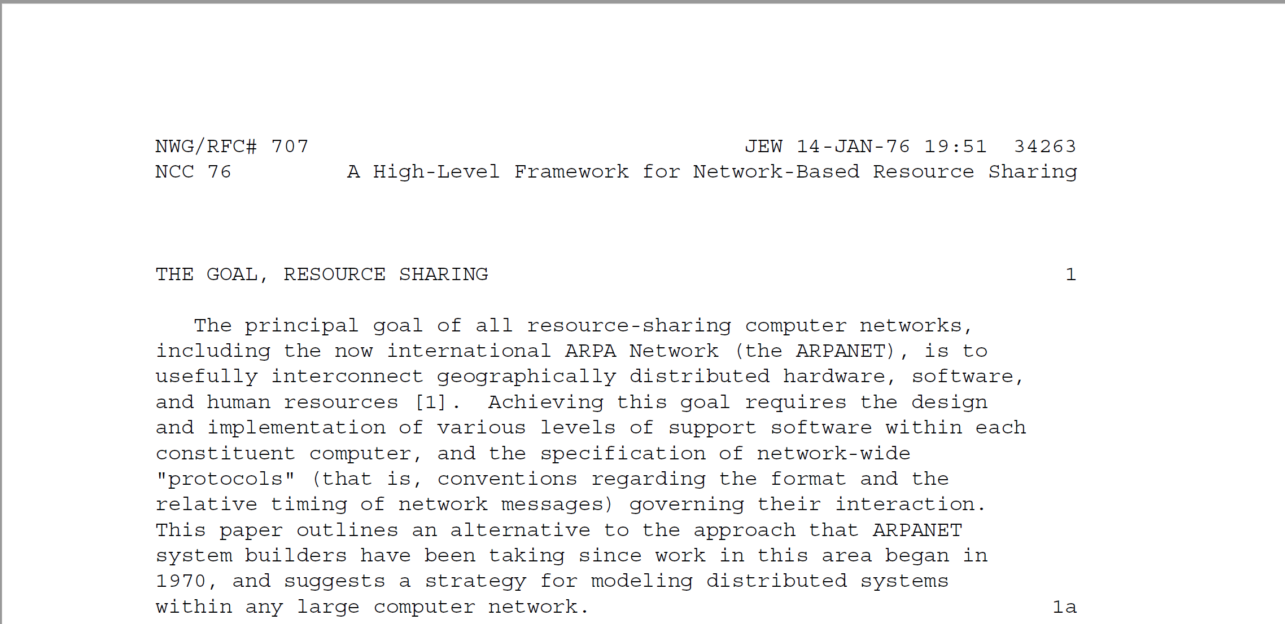
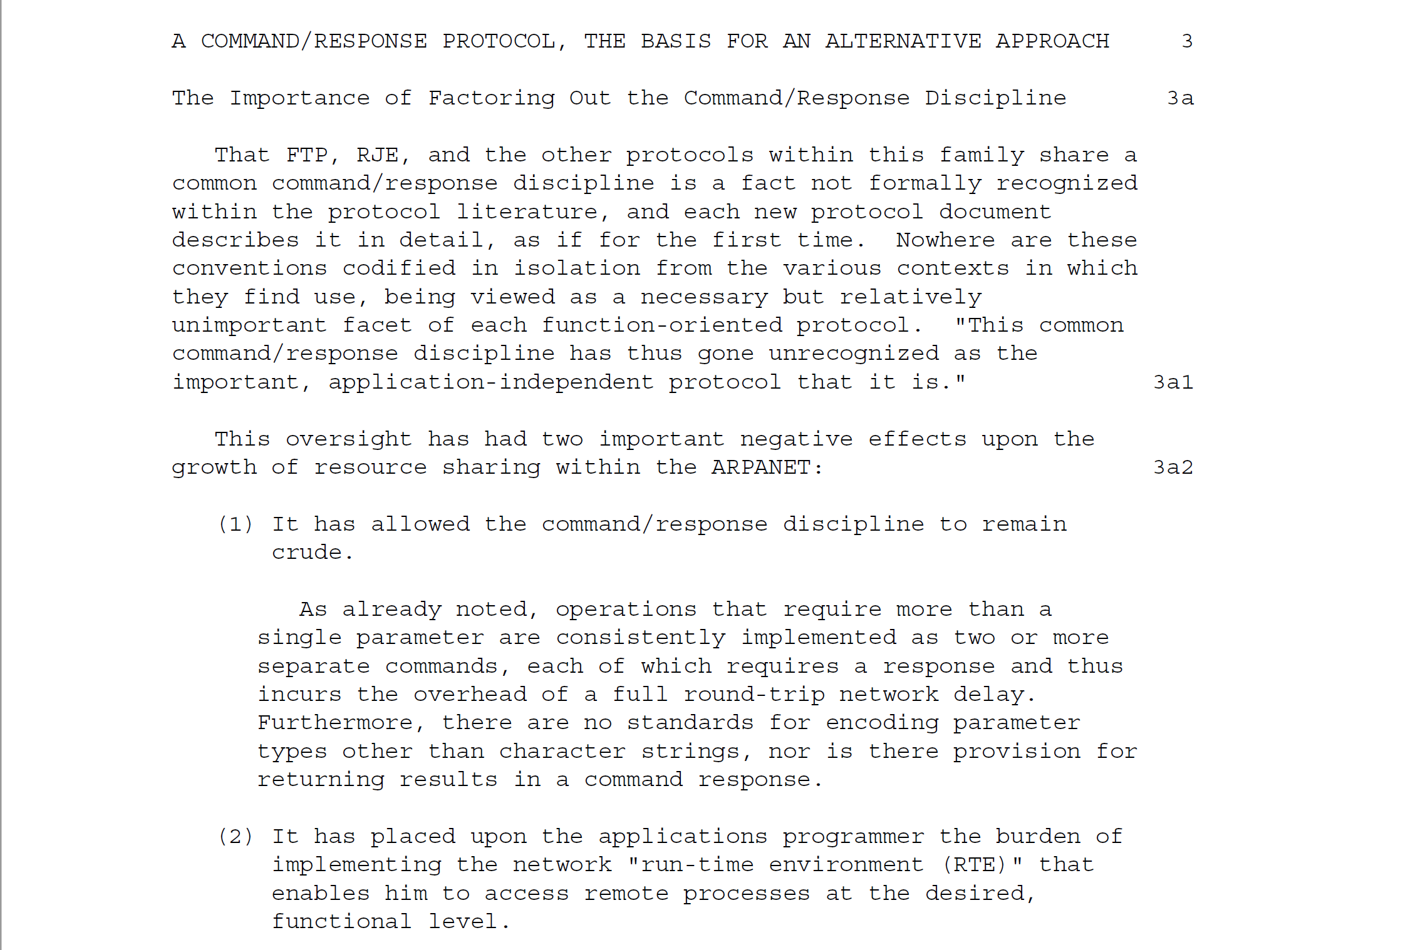
RFC 707
RFC 707 “A High-Level Framework for Network-Based Resource Sharing” is the first document to describe Remote Procedure Calls (RPC).
The RFC was authored by James White in 1976
Goal was to move away from human to application protocols (FTP, Email) towards application-application protocols
Notes:
Paper written in 1976 when most of the protocols for inter-process communication were oriented around a human being typing commands, and often part of batch processes. These inter-process communication protocols all had their own unique protocol forcing users to become familiar with a wide range of protocols when orchestrating software.

Slide 11
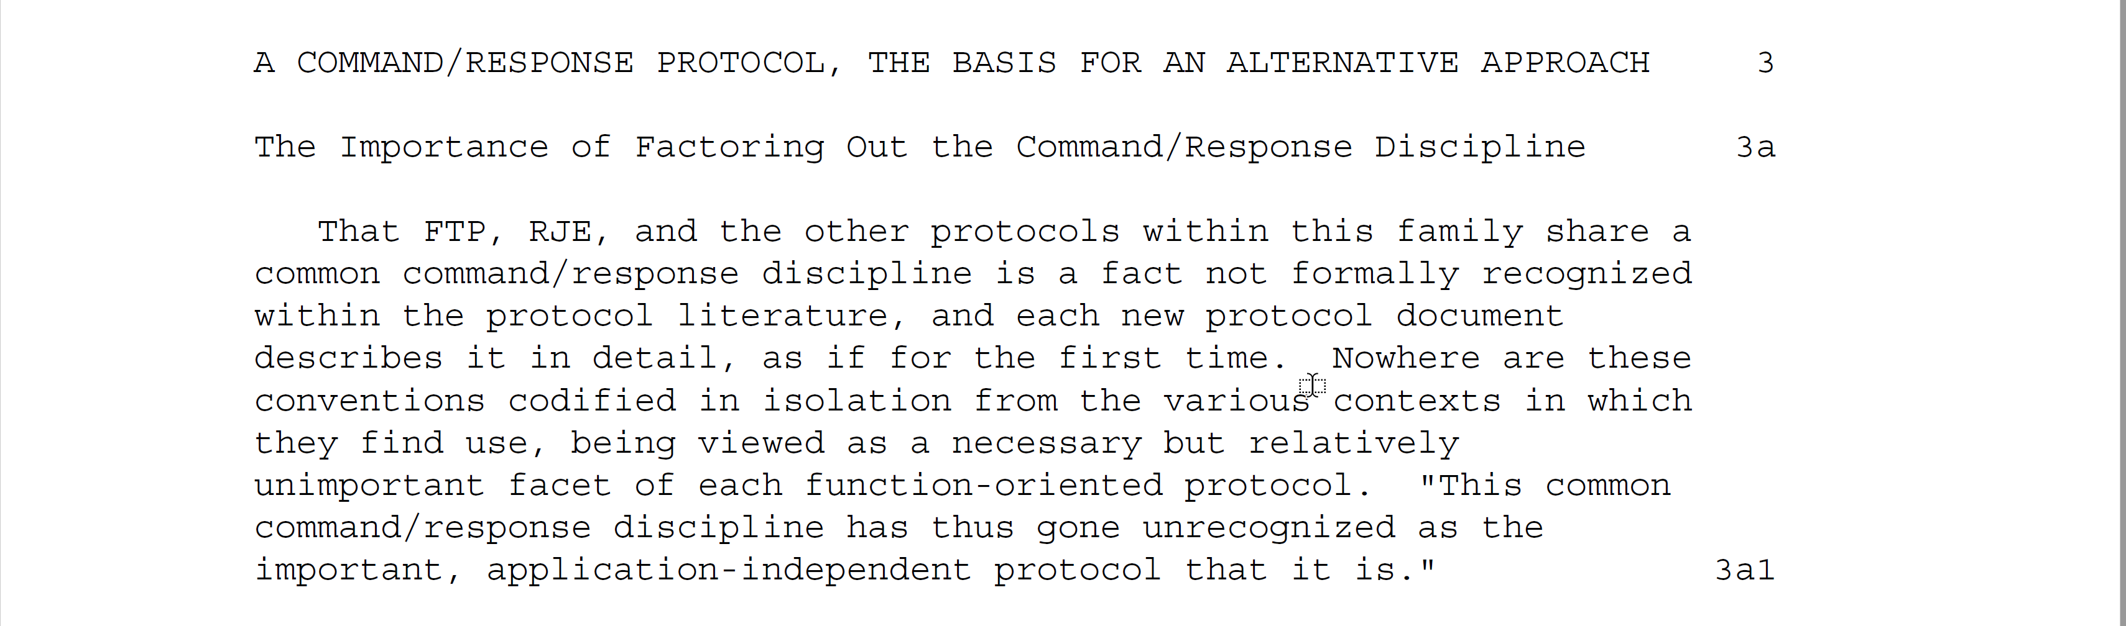
White identified that many of the protocols in use for inter-process communication (IPC) such as File Transfer Protocol (FTP), or Remote Job Execution (RJE) had a common: Command-Response pattern.
Notes:
All of these protocols have a similar approach. You issue a command, with come parameters, and you get a response back with a code for success or error. Although all used different names White identified that this pattern, which he called Command-Response was common to all of them.
White identified that Command-Response was the application-independent protocol: it was the pattern which all of the independent protocols followed.

Slide 12
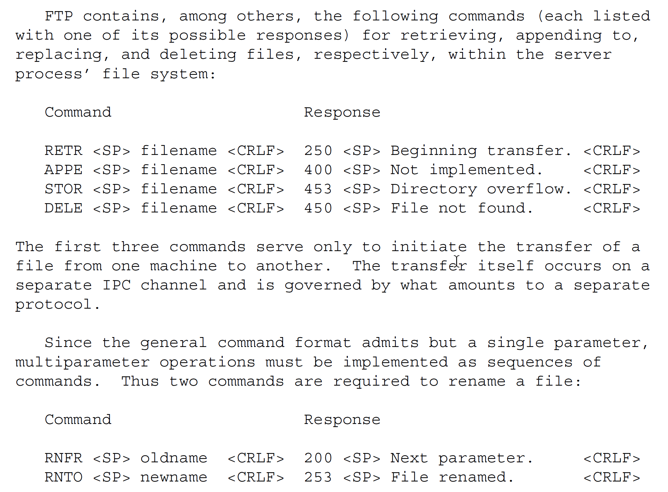
RFC 707 – James White

Slide 13
command-name <SP> parameter <CRLF>
response-number <SP> text <CRLF>
Notes:
FTP and RJE (Remote Job Execution have a common format)
This common command/response discipline requires that commands and responses have the following respective formats:
command-name <SP> parameter <CRLF>
response-number <SP> text <CRLF>
For example FTP has get <filename> or put <filename>
Each command invoked by the user process is identified by NAME and is allowed a single PARAMETER. Each response generated by the
server process contains a three-digit decimal response NUMBER (to be interpreted by the user process) and explanatory TEXT (for
presentation, if necessary, to the user). Response numbers are assigned in such a way that, for example, positive and negative
acknowledgments can be easily distinguished by the user process.

Slide 14
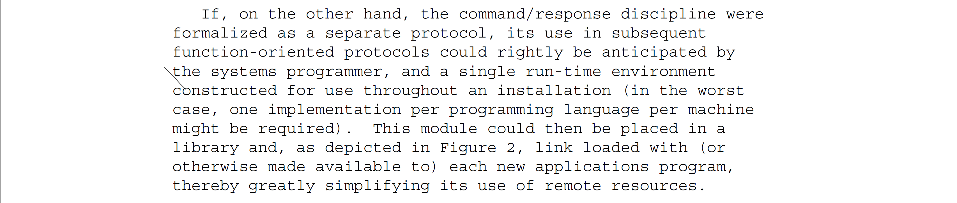
White argued that instead of application specific protocols the key to distributed computing was a protocol that supported command-response between two processes, allowing the user process to execute commands on the host.
Notes:
Instead of dealing with individual protocols I can have a library, for each programming language I need to use, that supports sending a command with parameters and receiving a response with either errors or text. Yes, each application has to define its own vocabulary of commands, but the grammar remains the same. As a developer I only need to learn how to use one library.
A single run-time environment constructed; a library per programming language to use that runtime; standard-approach, allowing interop

Slide 15
The Command-Response Protocol
Permit invocation of arbitrary, named commands (or functions) implemented by the remote process.
Permit command outcomes to be reported in a way that aids both the program invoking the command and the user under whose control it may be executing.
Allow an arbitrary number of parameters to be supplied as arguments to a single command.
Provide representations for a variety of parameter types, including but not limited to character strings.
Permit commands to return parameters as results as well as accept them as arguments.
Permit the server process to invoke commands in the user process, that is, eliminate entirely the often inappropriate user/server distinction, and allow each process to invoke commands in the other.
Permit a process to accept two or more commands for concurrent execution.
Allow the process issuing a command to suppress the response the command would otherwise elicit.
Notes:
Use HTTP as an example of how this works

Slide 16
message-type=COMMAND [tid] command-name arguments
message-type=RESPONSE tid outcome results
Notes:
COMMAND-RESPONSE
The first message invokes the command whose NAME is specified using the ARGUMENTS provided. The second is issued in eventual response to the first and returns the OUTCOME and RESULTS of the completed command. Whenever OUTCOME indicates that a command has failed, the command’s RESULTS are required to be an error number and diagnostic message, the former to help the invoking program determine what to do next, the latter for possible presentation to the user. The protocol thus provides a framework for reporting errors, while leaving to the applications program the tasks of assigning error numbers and composing the text of error messages.

Slide 17
message-type=REQUEST [tid] op-code arguments
message-type=REPLY tid outcome results
Notes:
REQUEST-REPLY
While the command/response model is a natural one, others are possible. A remote resource might also be modeled as a process that services and replies to requests it receives from other computer processes. This request/reply model would emphasize the fact that the Protocol is a vehicle for inter-process communication and that no human user is directly involved.
Substituting the request/reply model for the command/response model requires only cosmetic changes to the Protocol:
message-type=REQUEST [tid] op-code arguments
message-type=REPLY tid outcome results
In the formulation above, the terms "REQUEST", "REPLY", and "op-code" have simply been substituted for "COMMAND", "RESPONSE", and "command-name", respectively.
The choice of model need affect neither the content of the Protocol nor the behavior of the processes whose dialog it governs.
Use of the word "command" in the command/response model, for example, is not meant to imply that the remote process can be coerced into action. Whatever model is adopted, a process has complete freedom to reject an incoming remote request that it is
incapable of or unwilling to fulfill.

Slide 18
message-type=CALL [tid] procedure-name arguments
message-type=RETURN tid outcome results
Notes:
PROCEDURE-CONTROL-PROTOCOL (PCP)
Ideally, the goal of both the Protocol and its accompanying RTE is to make remote resources as easy to use as local ones. Since local resources usually take the form of resident and/or library
subroutines, the possibility of modeling remote commands as "procedures" immediately suggests itself. The Model is further confirmed by the similarity that exists between local procedures and
the remote commands to which the Protocol provides access. Both carry out arbitrarily complex, named operations on behalf of the requesting program (the caller); are governed by arguments supplied by the caller; and return to it results that reflect the outcome of the operation. The procedure call model thus acknowledges that, in a network environment, programs must sometimes call subroutines in machines other than their own.
Like the request/reply model already described, the procedure call model requires only cosmetic changes to the Protocol:
message-type=CALL [tid] procedure-name arguments
message-type=RETURN tid outcome results
In this third formulation, the terms "CALL", "RETURN", and "procedure-name" have been substituted for "COMMAND, "RESPONSE", and "command-name", respectively. And in this form, the Protocol might aptly be designated a "procedure call protocol (PCP)"

Slide 19
White called this: Procedure Control Protocol (PCP) though we would now call it Remote Procedure Call (RCP)

Slide 20
History: First Implementations

Slide 21
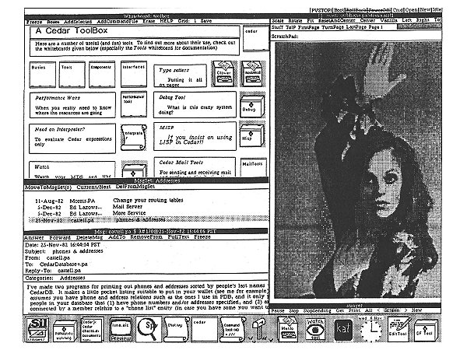
Implementing Remote Procedure Calls
Andrew D. Birrel and Bruce J. Nelson wrote a paper for Xerox Palo Alto Research Centre in 1984 called Implementing Remote Procedure Calls
It was an implementation of RPC for the Cedar programming language to allow distributed programming.
Notes:
The idea is that we want to widen the pool of people who can perform distributed systems programming, and to do that we have to simplify how we do this. Xerox Parc latched onto the idea of making a local call look like a remote call and having a runtime handle the complexity of the inter-process communication, and decided that it could demonstrate by implementing White’s ideas that it was straightforward for developers to build distributed systems.

Slide 22
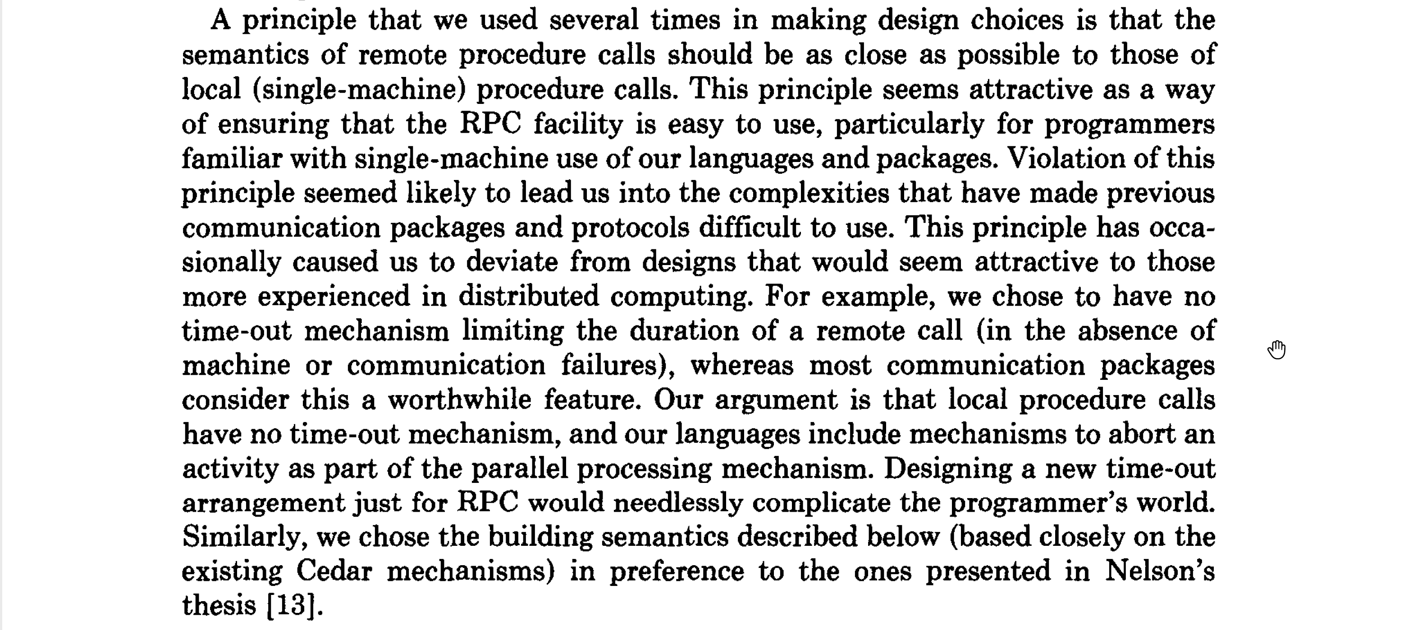
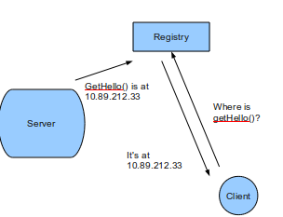
Location Transparency
Key principle was that that a remote procedure call should be ‘as close as possible to local (single-machine) procedure calls. A client should not need to know the location of the server.
Implementing Remote Procedure Calls, Birrel and Nelson, 1984

Slide 23
Interface Definition Language
The project defined the idea of an Interface Definition Language – called in this case Lupine.
Mesa (Cedar) separated compilation and binding through interface modules
These contained procedure definitions i.e. name, arguments, return type
Server lists exports and client imports to use definitions
Lupine used these modules to generate stubs for the caller and receiver.
The stubs provide code to marshal to and from the wire representation of the RPC runtime.
Notes:
COM and CORBA’s IDL, WSDL for SOAP, the langage used by gRPC
RPCRuntime is a standard part of the Cedar system. The user and server are
written as part of the distributed application. But the user-stub and server-stub
are automatically generated, by a program called Lupine. This generation is
specified by use of Mesa interface modules. These are the basis of the Mesa (and
Cedar) separate compilation and binding mechanism [9]. An interface module is
mainly a list of procedure names, together with the types of their arguments and
results. This is sufficient information for the caller and callee to independently
perform compile-time type checking and to generate appropriate calling sequences.
A program module that implements procedures in an interface is said to
export that interface. A program module calling procedures from an interface is
said to import that interface. When writing a distributed application, a programmer
first writes an interface module. Then he can write the user code that imports
that interface and the server code that exports the interface. He also presents
the interface to Lupine, which generates the user-stub, (that exports the interface)
and the server-stub {that imports the interface). When binding the programs on
the 'caller machine, the user is bound to the user-stub. On the callee machine,
the server-stub is bound to the server. (protobuf based) are all just modern implementations of this idea.

Slide 24
Service Registration & Discovery
If the call looks like a local procedure call, how do we know where the server is that will service the request?
Birrel and Nelson used a distributed key-value store called Grapevine.
The server runtime exports its interface names, along with server name and network location. i.e. service registration
A client requests from the runtime servers that provide the interface and then routes the request (in this case to the closest) i.e. service discovery
Notes:
Also created the idea of service discovery. To make this seamless the programmer doesn’t want to understand that they are making a network call, so how does the runtime make the call? The simple answer is that we need to register processes that can provide given procedures and allow the runtime to lookup those instances when it needs to make a call and route the call to an available instance. The client developer doesn’t need to be aware of the address of the server – the runtime needs to be aware of the server.
Now: etcd, zookeeper, consul are used for service registration and discovery.

Slide 25
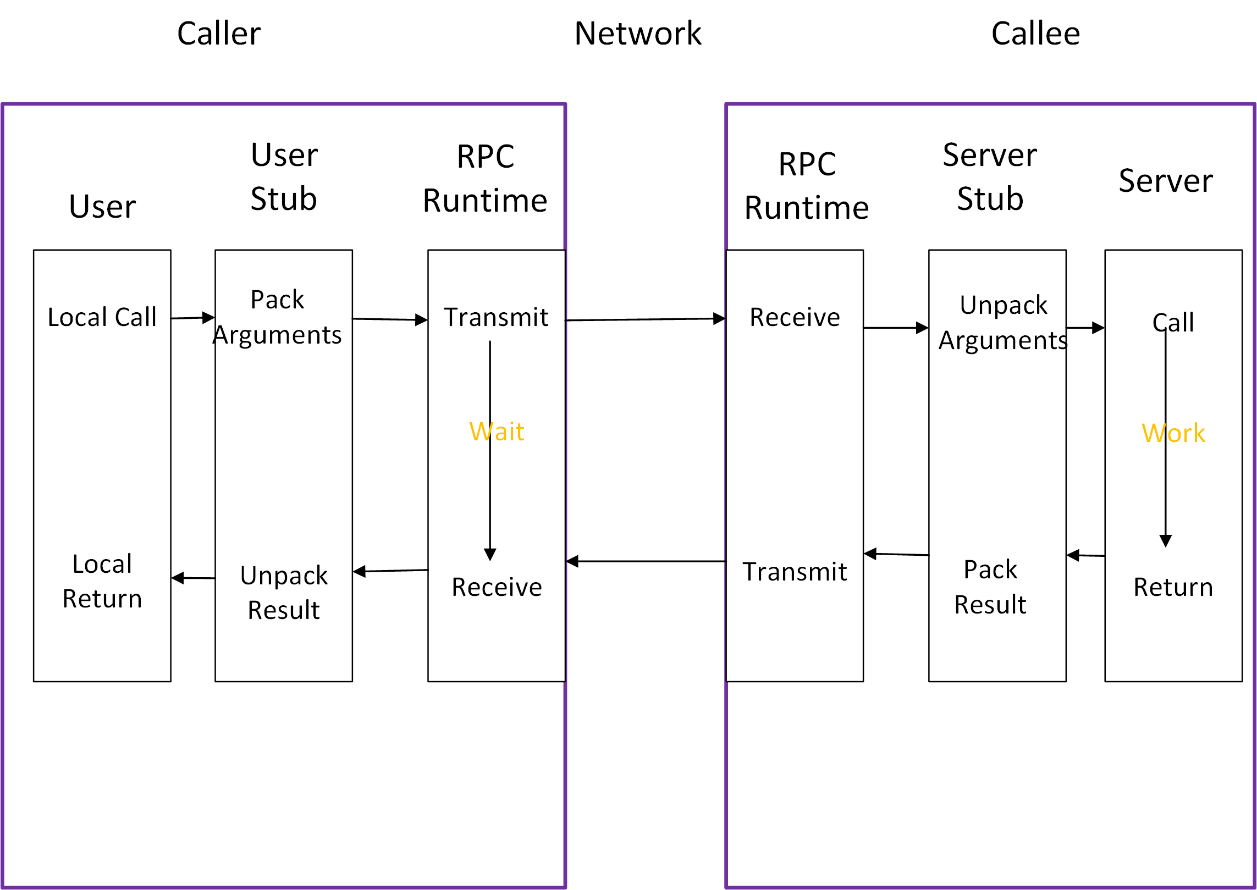
Notes:
The program structure we use for RPC is similar to that proposed in Nelson' thesis. It is based on the concept of stubs. When making a remote call, five pieces of program are involved: the user, the user-stub, the RPC communications package (known as RPCRuntime), the server-stub, and the server. Their relatidnship is shown in Figure 1. The user, the user-stub, and one instance of RPCRuntime execute in the caller machine; the server, the server-stub and another instance of RPCRuntime execute in the callee machine. When the user wishes to make a remote call, it actually makes a perfectly normal local call which invokes a corresponding procedure in the user-stub. The user-stub is responsible for placing a specification of the target procedure and the arguments into one or more packets and asking the RPCRuntime to transmit these reliably to the callee machine. On receipt of these packets, the RPCRuntime in the callee machine passes them to the server-stub. The server-stub unpacks them and again makes a perfectly normal local call, which invokes the appropriate procedure in the server. Meanwhile, the calling process in the caller machine is suspended awaiting a result packet. When the call in the server completes, it returns to the serverstub and the results are passed back to the suspended process in the caller machine. There they are unpacked and the user-stub returns them to the user.
RPCRuntime is responsible for retransmissions, acknowledgments, packet routing, and encryption. Apart from the effects of multimachine binding and of machine or communication failures, the call happens just as if the user had invoked the procedure in the server directly. Indeed, if the user and server code were brought into a single machine and bound directly together without the stubs, the program would still work.

Slide 26
History: Distributed Objects

Slide 27
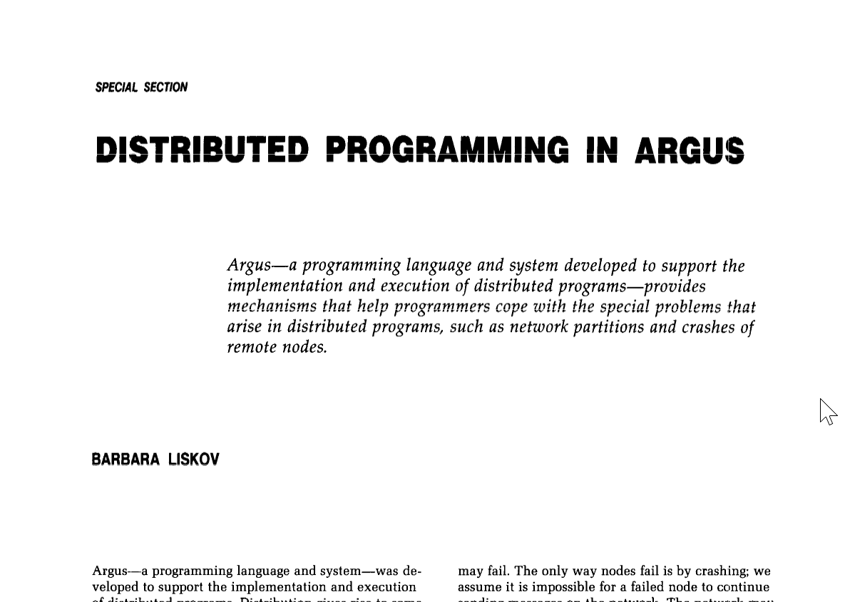
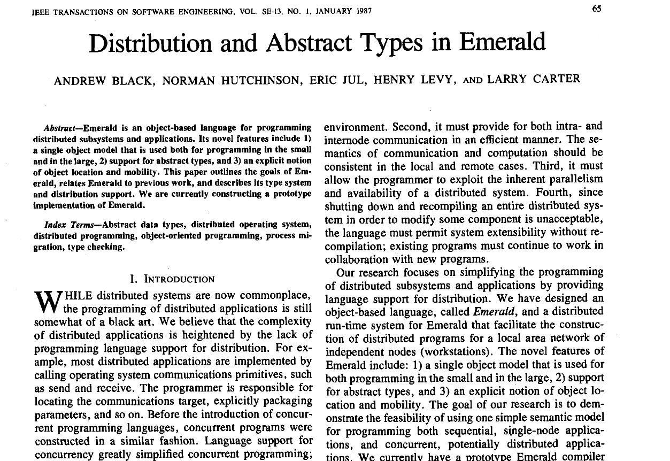
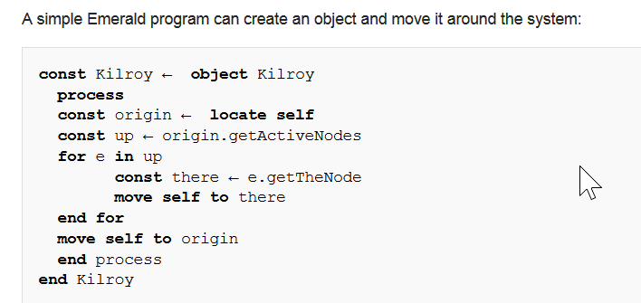
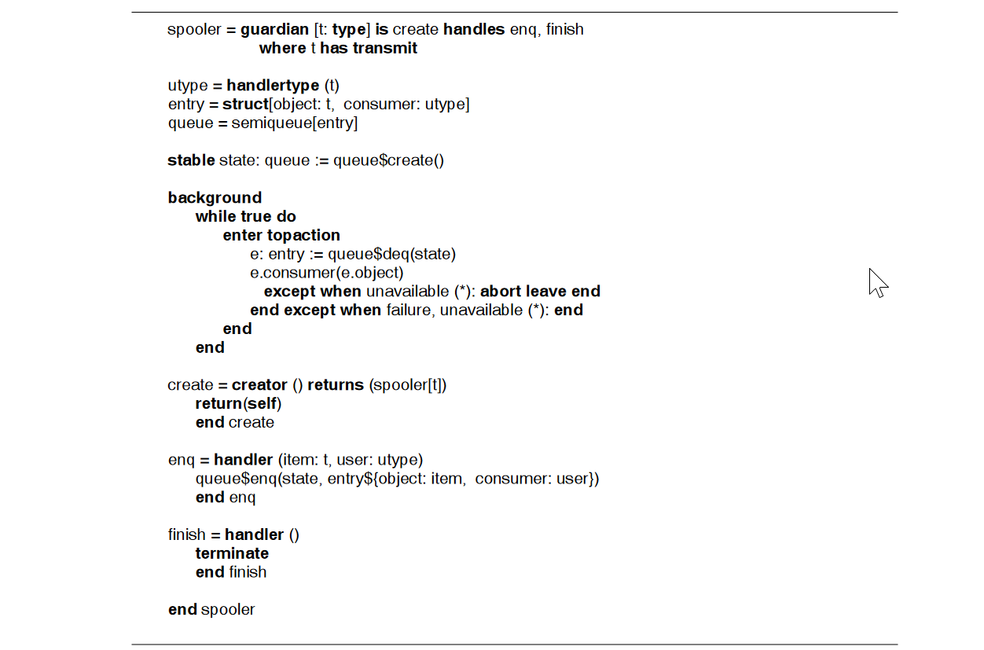
B Liskov 1988
A Black, N Hutchinson, E Jul, H Levy, L Carter - 1987

Slide 28
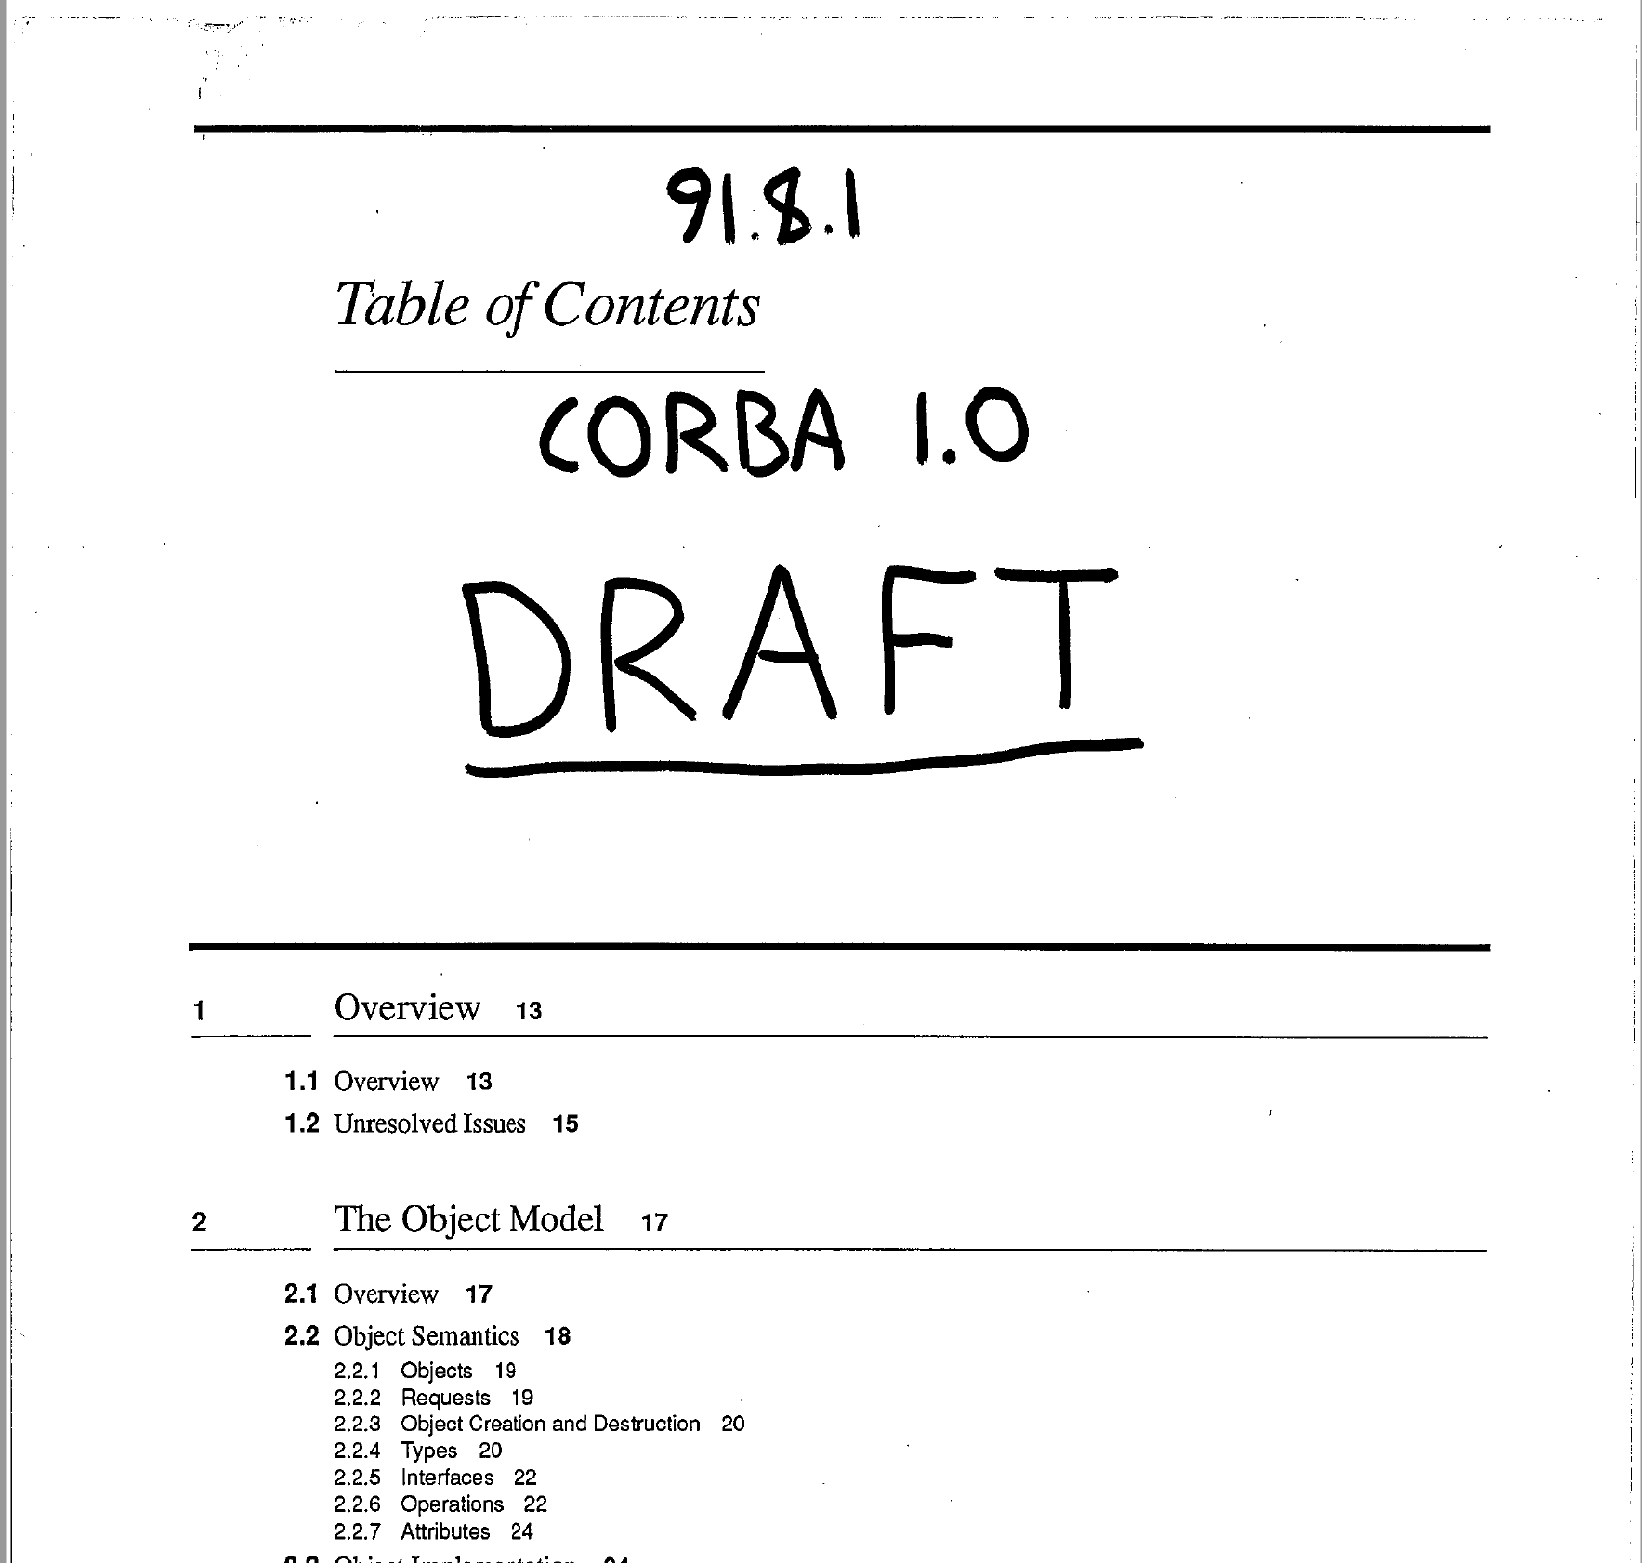
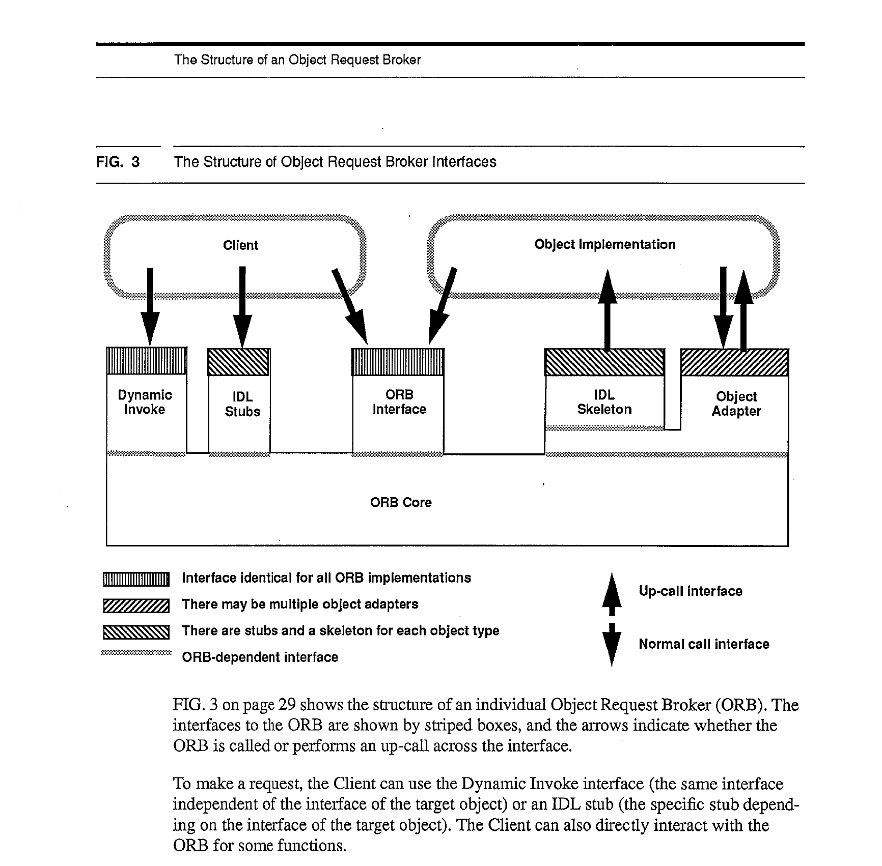
Notes:
In 1991 CORBA emerged, and began the era of commercial use of distributed objects, particularly from C and C++ initially, later Java.

Slide 29
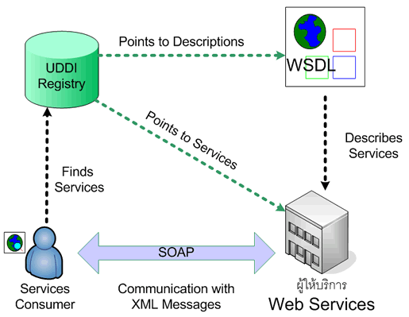

Slide 30
Distributed Objects
CORBA
DCOM
Java RMI/.NET Remoting
SOAP
Pyro
(Etc.)
Notes:
CORBA
DCOM
Java RMI/.NET Remoting
SOAP/WSDL
Pyro
In distributed computing, distributed objects^{[citation needed]} are objects (in the sense of object-oriented programming) that are distributed across different address spaces, either in multiple computers connected via a network or even in different processes on the same computer, but which work together by sharing data and invoking methods. This often involves location transparency, where remote objects appear the same as local objects. The main method of distributed object communication is with remote method invocation, generally by message-passing: one object sends a message to another object in a remote machine or process to perform some task. The results are sent back to the calling object.
Distributed objects were popular in the late 1990s and early 2000s, but have since fallen out of favor.^{[1]}

Slide 31
Make a Good Cup of Tea
“Now this is serious! if there’s one thing in this country that really bothers me/ Its’ the inability of yanks to make a good cup of tea”
T.U.S.A. Masters of Reality.

Slide 32
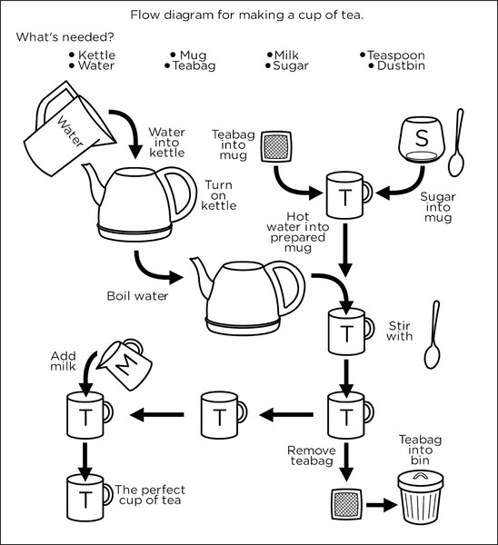

Slide 33
Demo

Slide 34
Nobody Home
“And that is how I know/When I try to get through/On the telephone to you/There'll be nobody home.”
Nobody Home. Pink Floyd

Slide 35
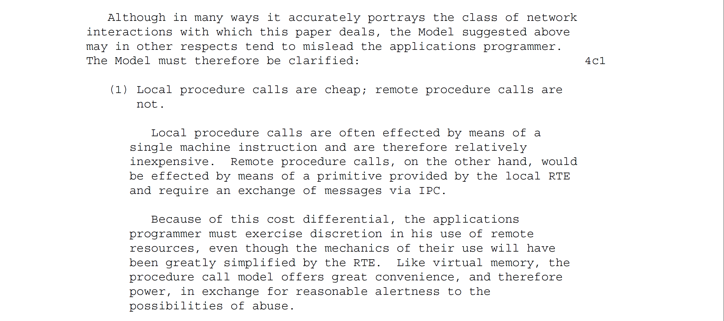
A local call is not a remote call
RFC 707 admits that making a remote procedure call look like a local one has drawbacks because it ‘hides’ the downsides from the developer
Notes:
A local call is on the stack, it won’t fail. But a remote call is over the network, it can fail. So suddenly I am exposed to a deception, the paradigm I am using implies that I will not get communication errors, but I might. How will that manifest? An error code, an exception? And if I have to code for error codes or exceptions that might occur as part of this call, do I really have location transparency? Have I really lowered the bar, reduced the barrier to entry in distributed programming? Or have I just introduced hidden complexity via a leaky abstraction.

Slide 36

Is my cup of tea being made, or is there an error on the server?
Can I talk to the server right now? Is it busy? Is it gone?
What happens if there is a problem making my cup of tea? How will I know?

Slide 37
Temporal Coupling
The server must be available when you call.
Notes:
The server must be available when you call.
if I make a phone call, and you are not there I am shit out of luck. RPC is a phone call, direct communication between two participants and can be frustrating if you get a busy tone or no one answers. (nowadays we may leave an answer phone message, or send a text, but this is messaging not RPC). We will come to that later.
Pooling of resources can help here – one of anything can fail, so you need multiple servers
To avoid the client now having to know about where a server lives, which again defeats concept of RPC, then you have to use service-discovery in your runtime, so that location is hidden to caller. Good idea anyway, even if location transparency not our goal, not to have a fixed location.
Not true of decoupled invocation i.e. messaging of course.
“... the degree to which the sending and handling of a message are connected in time. If a sender is dependent on a receiver being available when a message is sent, we have high temporal coupling... Processes whose activities are strictly ordered or whose results carry forward, leaving subsequent activities unable to start until a response to a prior request has been received, are similarly temporally coupled. “ Ian Robinson

Slide 38
Latency
“The most obvious difference between a local object invocation and the invocation of an operation on a remote (or possibly remote) object has to do with the latency of the two calls. The difference between the two is currently between four and five orders of magnitude, and given the relative rates at which processor speed and network latency speeds are changing, the difference in the futurepromises to be at best no better, and will likely be worse.”
A Note on Distributed Computing, Waldo et al. 1994
Notes:
“Ignoring the difference between the performance of local and remote invocations can lead to designs whose implementations are virtually assured of having performance problems because the design requires a large amount of communication between components that are in different address spaces and on different machines. Ignoring the difference in the time it takes to make a remote object invocation and the time it takes to make a local object invocation is to ignore one of the major design areas of an application. A properly designed application will require determining, by understanding the application being designed, what objects can be made remote and what objects must be clustered together.” – A Note on Distributed Computing

Slide 39
Blocking Calls
RPC blocks whilst it waits for a response.
Are you done, or have you failed?
Notes:
RPC blocks whilst it waits for a response.
A blocked thread is a wasted thread.
Wait, can’t we just use an asynchronous call
Asynchronous RPC calls are an oxymoron. If you are accounting for calling over a network, then you are not the same as a local procedure call
How do I know that you are done, or have failed?
You need to use a timeout – but again, this is not local procedure call dynamics, we are network aware to do that.
Cedar had no timeout, for exactly this reason.

Slide 40
The network is reliable.
Latency is zero.
Bandwidth is infinite.
The network is secure.
Topology doesn't change.
There is one administrator.
Transport cost is zero.
The network is homogeneous.
Notes:
The Fallacies of Distributed Computing

Slide 41
Leaky Abstraction
Notes:
RPC is a leaky abstraction because it obscures the underlying protocol from the programmer.
Remember how we complained about WebForms because it obscured the semantics of HTTP i.e. uniform interface and request-response? We have the same problem with RPC, it does not help us understand the underlying notion of what we are doing: sending a request to another process, and waiting for a response from that process. As such it prevents software developers working effectively with the underlying protocol. It is too high a level of abstraction.

Slide 42
Demo

Slide 43
Rage Against the Machine
“F*@k you I won’t do what you tell me!”

Slide 44

What goes in the cup first? Tea or milk?
Perhaps new information leads us to believe our old approach, tea first is not correct, and we should put the milk in first.
But if f the client is the ‘locus of control’, then we have to change all clients to effect this change.
Notes:
The client should not have the expertise about how to make tea. That belongs to the server, it is the ‘expert’ on making tea not the client. We don’t want to have to tell the client if we have a better way of making tea, we just want to serve them better tea.
In OO we call this problem feature envy – our calls to the client to adjust properties or call methods means that the business logic bleeds out into the client rather than being in the server.
We lose information hiding.
Parnas in ‘On the criteria to be used for the decomposition of software into modules’ says: don’t use a flowchart, that is the wrong approach to finding modules, use information hiding as the key to deciding what modules to create. We should not base our programme structure on the steps to make tea, but around information hiding on the process of tea making.

Slide 45

We want to change the algorithm used to make tea, without changing the client.
It’s possible local traditions around tea are different. Perhaps we need to make tea not with milk, but black. We might need to add lemon or rose petals!
So we might want to make a runtime decision on the algorithm to use depending on location!
We would like our server to work in all these circumstances, so the client should not hold behavior.

Slide 46
Behavioral Coupling
Notes:
“...the degree to which parties share assumptions regarding behaviors, more specifically, to the implications of assigning the twin responsibilities for determining what action to execute and how to execute that action to the parties in a distributed interaction. In systems that exhibit an extremely high degree of behavioral coupling, the sender of a message determines what to do, and also knows something of how the receiver ought satisfy its request... High behavioral coupling requires a provider to evolve its service offerings in response to changed consumer requirements” Ian Robinson
Control coupling Control coupling is one module controlling the flow of another, by passing it information on what to do (e.g., passing a what-to-do flag).
The problem with a procedural style is that the client is the locus of control – it decides the calls and their sequence.
This means that domain knowledge, or expertise belongs to the client, not the server.
In OO we call this problem feature envy. The Law of Demeter applies.
Shouldn’t the server be the expert?

Slide 47
Demo

Slide 48
Do You Speak My Language?
“I said ‘Do you speak my language’…she just smiled and gave me a vegemite sandwich”

Slide 49

If I am expecting a tea bag, and you turn up with loose tea, we may have an issue. I may not have a strainer. Am I happy with loose tea in my cup?

Slide 50
When two components on the same platform (language & framework) talk to each other, then the interface between them usually “just works.”
But when we use different languages and platforms we may have to do work just to marshal between one environment and another.
For example Visual Basic and C have very different string representations – this means you have to marshal in your code.

Slide 51
Impedance Mismatch

Slide 52
Toxicity
“Conversion. Software version 7.0”

Slide 53
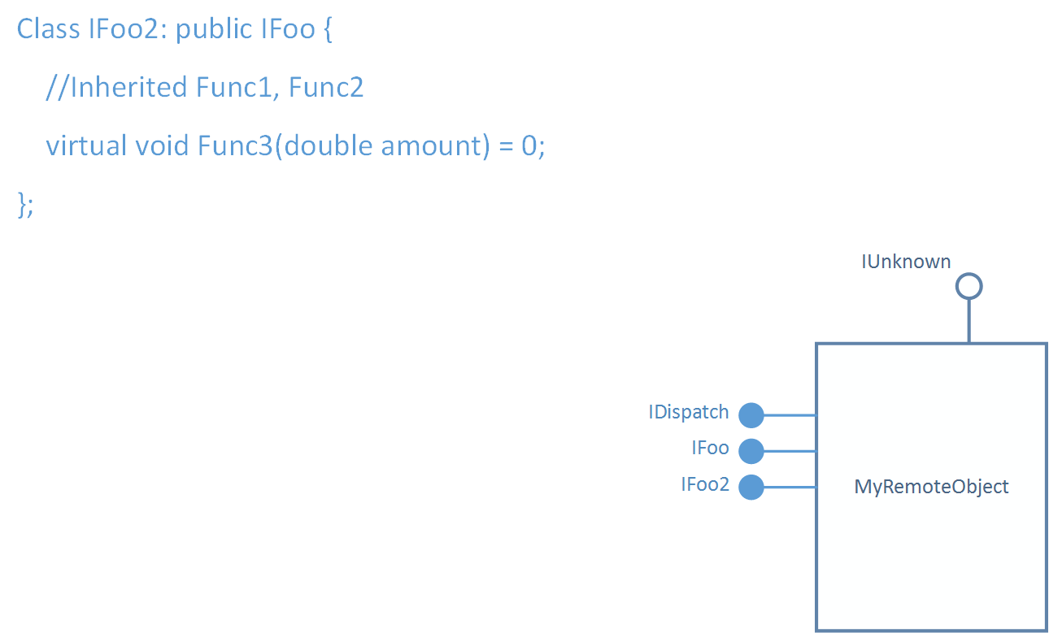
Notes:
If I generate my stub from your interface, then I expect it to have a certain shape. If you want to change it there are now some problems – I may have generated code from an older version, so I will make incompatible calls if you change arguments or return types. This will break your clients, which does not make you popular. In some runtimes even extending your interface can cause breakages because the change is binary incompatible.
For this reason versioning with RPC tends to require adding a new interface, that derives from the old one to support the amended functionality.
Clients that are aware of the change use the new interface, clients that are not, use the old one.
This leads to a proliferation of interfaces – which lowers the usability of your API over time.

Slide 54
Message in a Bottle
“I hope that someone gets my message in bottle”

Slide 55
A Critique of the Remote Procedure Call
Once we admit that true transparency is impossible, and that programmers must know which calls are remote and which ones are local, we are faced with the question of whether a partially transparent mechanism is really better than one that was designed specifically for remote access and makes no attempt to make remote computations look local at all.
Andrew S. Tannebaum and Robbert van Renesse
Notes:
A Critique of the Remote Procedure Call, white paper by Andrew S. Tannebaum and Robbert van Renesse

Slide 56
A Note on Distributed Computing
“Every ten years (approximately), members of the language camp notice that the number of distributed applications is relatively small. They look at the programming interfaces and decide that the problem is that the programming model is not close enough to whatever programming model is currently in vogue... A furious bout of language and protocol design takes place and a new distributed computing paradigm is announced that is compliant with the latest programming model. After several years, the percentage of distributed applications is discovered not to have increased significantly, and the cycle begins anew.”
Jim Waldo, Geoff Wyant, Ann Wollrath, and Sam Kendall

Slide 57
“A less optimistic explanation of the failure of each attempt at unification holds that any such attempt will fail for the simple reason that programming distributed applications is not the same as programming non-distributed applications. Just making the communications paradigm the same as the language paradigm is insufficient to make programming distributed programs easier, because communicating between the parts of a distributed application is not the difficult part of that application.”
Jim Waldo, Geoff Wyant, Ann Wollrath, and Sam Kendall

Slide 58
“The hard problems in distributed computing are not the problems of how to get things on and off the wire. The hard problems in distributed computing concern dealing with partial failure and the lack of a central resource manager. The hard problems in distributed computing concern insuring adequate performance and dealing with problems of concurrency. People attempting to write distributed applications quickly discover that they are spending all of their efforts in these areas and not on the communications protocol programming interface.”
Jim Waldo, Geoff Wyant, Ann Wollrath, and Sam Kendall

Slide 59
RFC 684
RFC 684 by Richard Schantz, A Commentary on Procedure Calling as a Network Protocol.
It is a criticism of RPC (PCP) and pre-dates RFC 707
It prefers request-reply as the approach to IPC.
Believes that distributed systems on the right track, to that point
It recommends preferring co-operating processes over the client as locus of control.
Notes:
Procedure calling is most often a very primitive operation whose implementation often requires only a single machine instruction. In addition, it is usually true that procedure calling
is usually not within the domain of the operating system…. Processes and communication paths between processes, however, are undeniably operating system constructs. In an environment where local procedure calling was "cheap", it would be ill-advised to blur the distinction between a local (inexpensive in time and effort) and a remote procedure call, which obviously requires a great deal of effort by the "PCP system", if not by the PCP user. It also seems to be the case that the cost of blurring the local/remote distinction at the procedure call level will be found in the more
frequent use of a less efficient local procedure calling mechanism.
Interprocess communication, on the other hand, (at least with regard to stream or message oriented channels and not just interrupt signals) is generally regarded as having a significant cost
associated with it. Message sending is always an interprocess action, and requires system intervention always. There is not as substantial a difference between the IPC of local processes and the
IPC of remote processes, as between local and remote procedure calling. PCP is suggestive of a model in which processes exist that span machine boundaries to provide inter-machine subroutine calling.
Yet the PCP documentation has not advocated the notion of a process that spans machine boundaries, and rightfully so since such a creation would cause innumerable problems. Since procedure calling is more suitable as an intra-process notion, it seems to be a better idea to take the interprocess communication framework and extend it to have a uniform interpretation locally and remotely, rather than to extend the procedure calling model

Slide 60
Prefer Messaging
Notes:
It may be worth pointing out here that RFC criticizes PCP but does not share the same scorn for Command-Response or Request-Reply.
A lot of the goals are still valuable: I want to make an IPC call and I want the complexity handled for me: a client stub that handles creating the message to be sent over the wire, a runtime that handles service discovery and transmission and receipt of the message, and a server stub that routes the message to handling code.
For example Brighter handles much of this: it is a command dispatcher and you write a handler. You can locate the handler in a local or remote process. We provide the stub and runtime to help you transmit and receive. BUT we make it explicit whether you are making a local call or a remote call (Send/Publish vs. Post) and we dispatch a message to a handler, we do not invoke a procedure, so the server can vary the handler implementation without the client knowing.
Use AMQP, use REST. Don’t use RPC

Slide 61
Demo

Slide 62


A Command
An Event
Notes:
We may prefer and event to a command when integrating.
A Command says: Do this thing i.e. Make me a cup of tea. This works if the client is there, I will get a cup of tea, but if the client is not I must have used some middleware in the runtime to guarantee at least once delivery. You might also refuse me, perhaps you are busy.
An Event says: Here is the state I am in. Can you help? We are open here to anyone handling it. I don’t care who gets me tea, I just want tea. Some potential tea bringers may be busy, but another one might bring me tea.

Slide 63
Who’s Better, Who’s Best

Slide 64
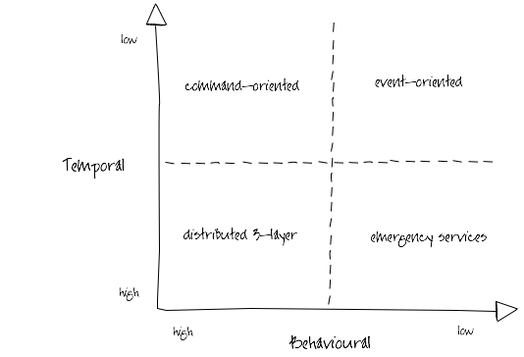
Ian Robinson: http://iansrobinson.com/2009/04/27/temporal-and-behavioural-coupling/
Notes:
Distributed 3-layer
Traditional 3-layer application architecture blown up to distributed proportions. Characterized by call stack-like, imperative behaviour (high temporal and behavioural coupling) and synchronous request-response interactions. Includes systems that layer synchronous interactions on top of asynchronous message exchanges. Senders tell receivers what to do; receivers execute the sender’s orders. Sender and all intermediaries block until the call stack unwinds, effectively locking and/or consuming system resources further up the call chain. This blocking behaviour undermines the autonomy of upstream components and at the same time increases the availability requirements of downstream components. As Michael Nygard’s Release It! reminds us, in these circumstances the availability of the overall system can be no more than that of the least available participant, and the probability of failure is the joint probability of failure in any component or service.
Command-oriented
“Good”, “orthodox” SOA. Low degree of temporal coupling characterised by asynchronous interactions, deferred state and a resumable programming model (process or activity instances are dehydrated between remote invocations in order to conserve resources, and then rehydrated based on correlated responses). Senders typically determine what needs to be done, but rely on receivers to determine how to execute their instructions. This behavioural coupling can require providers to evolve (message formats, supported operations) in lockstep with changing consumer demands.
Event-oriented
Low temporal and behavioural coupling. Receivers determine both what needs to be done and how to do it based on the content of received messages. Resumable programming model: processes are suspended or dehydrated, waiting for events. Can be difficult to trace the execution path of an end-to-end transaction or activity. Exposing an ExtinguishFire operation is a command-oriented way of executing a business process; acting on FireStarted notifications an event-oriented approach.
Emergency services
So called because you tell them what happened, and they decide what to do, but if there’s no one to take your call, you’re hosed. Low behavioural coupling, which allows for the independent evolution of system components, but a degree of temporal coupling, impacting availability requirements of participants. Many RESTful solutions occupy this quadrant. URI-templated solutions have a higher degree of behavioural coupling than hypermedia-driven solutions (where servers constrain and guide what a client can do next, and determine how best to satisfy requests); client polling and caching can mitigate some of these temporal coupling issues.

Slide 65
Summary
What has gone before us.

Slide 66
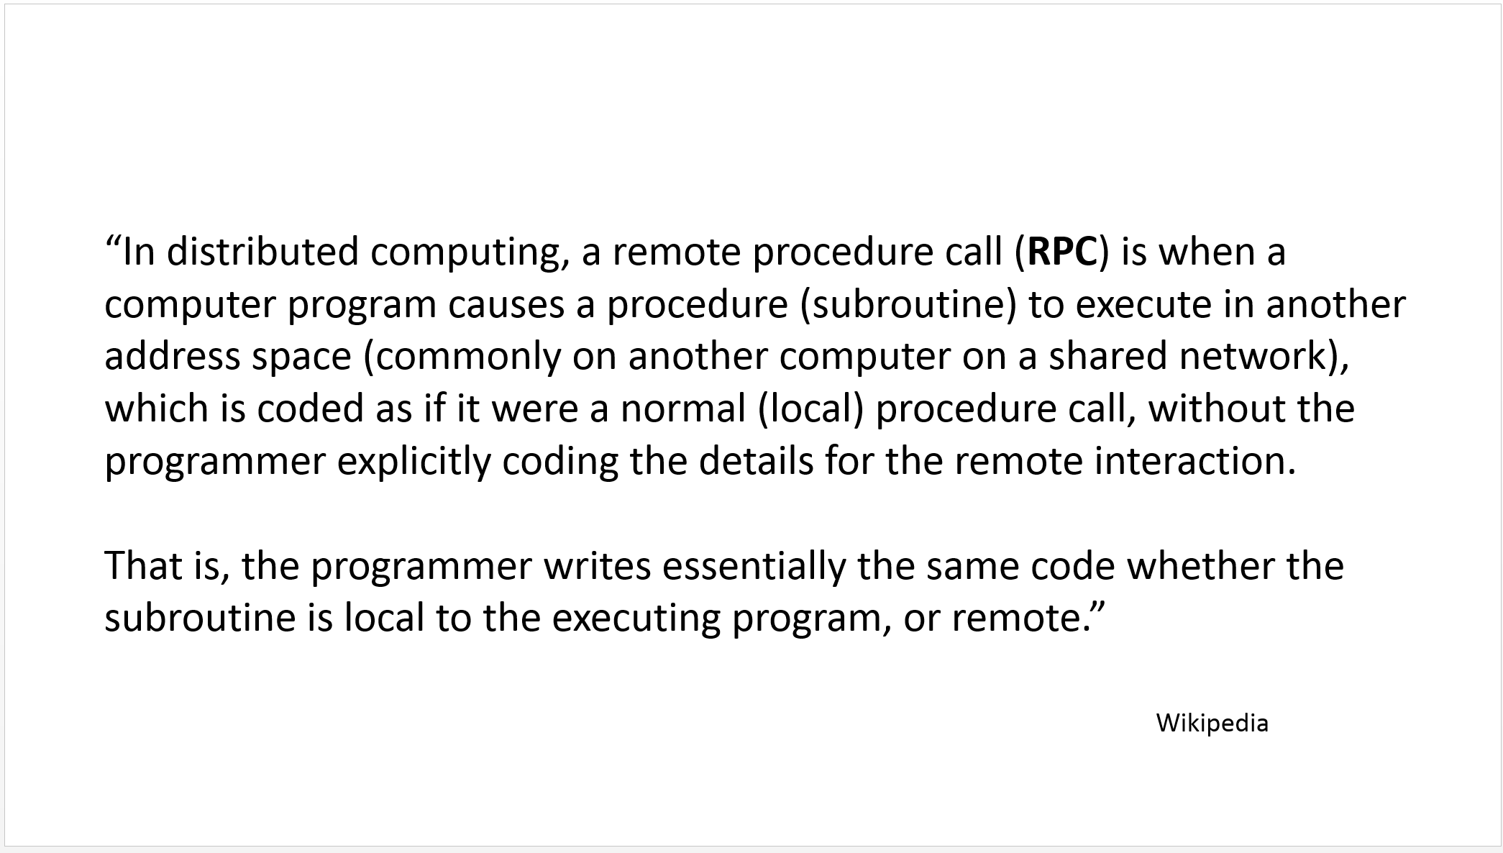
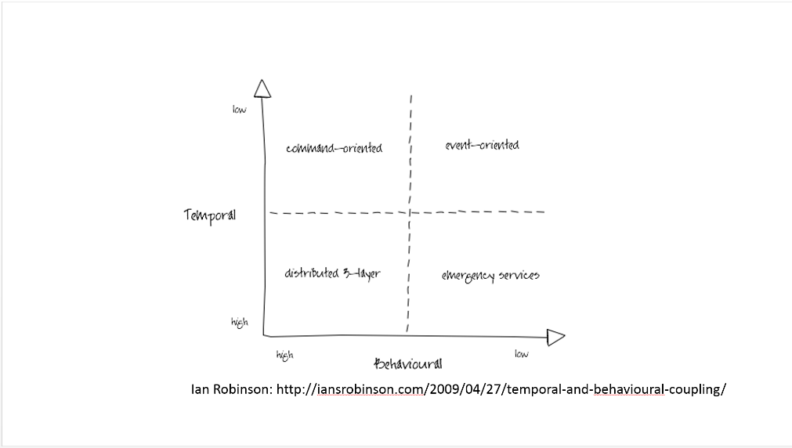
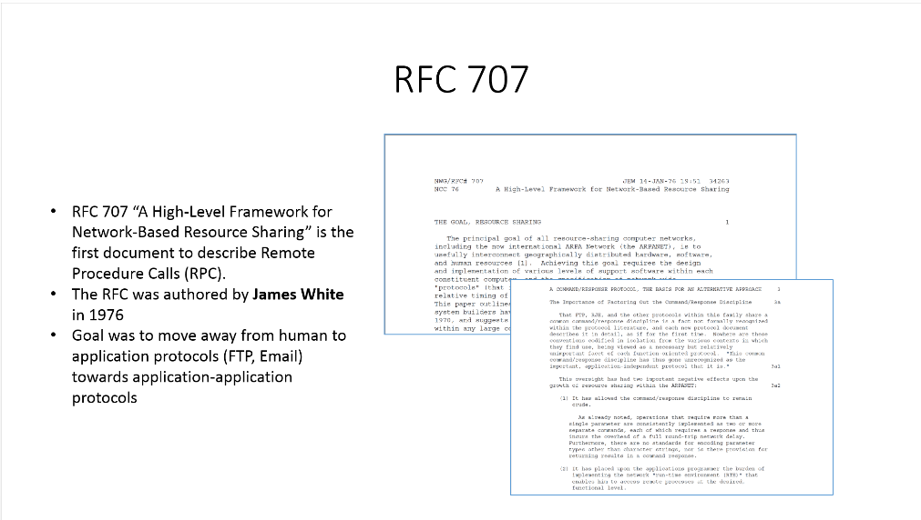
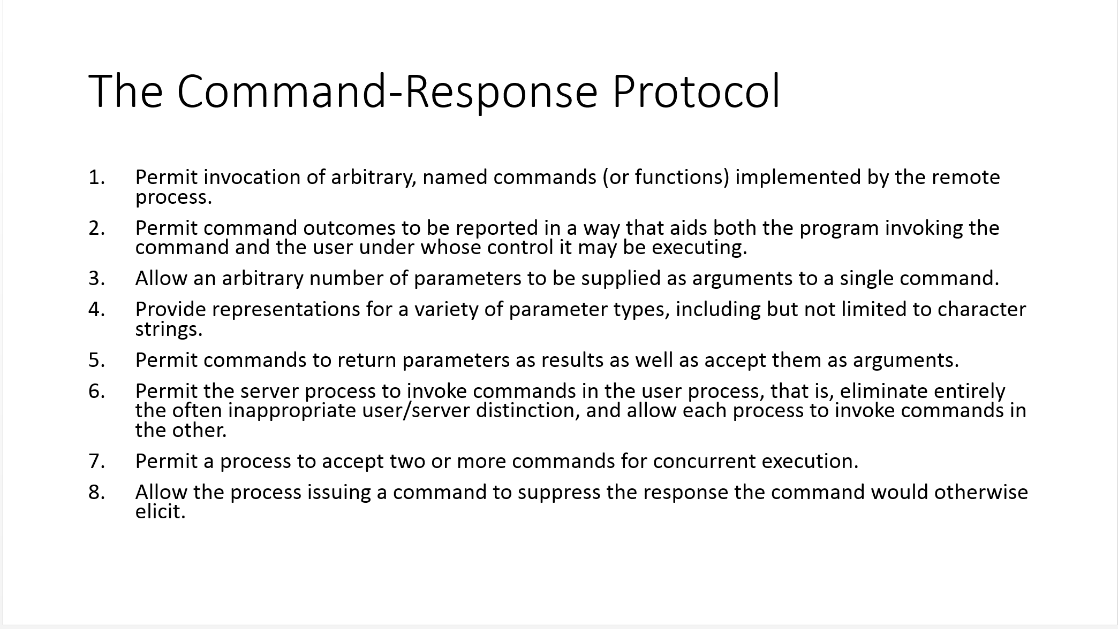
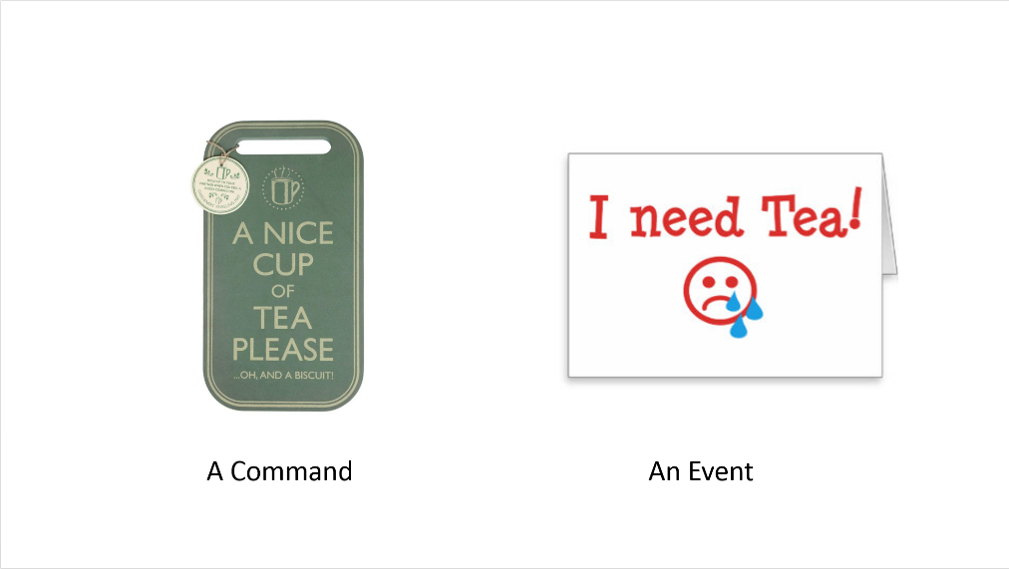
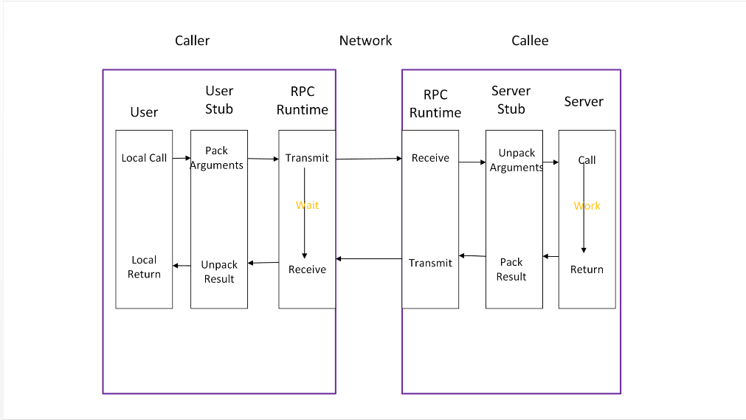
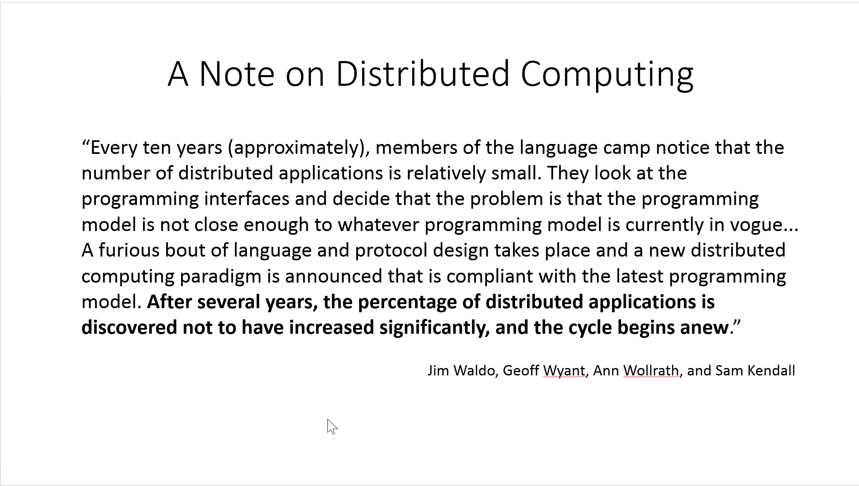
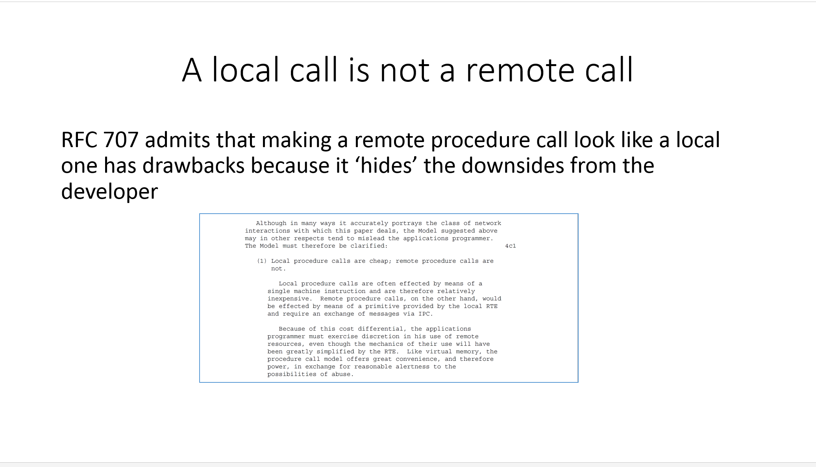
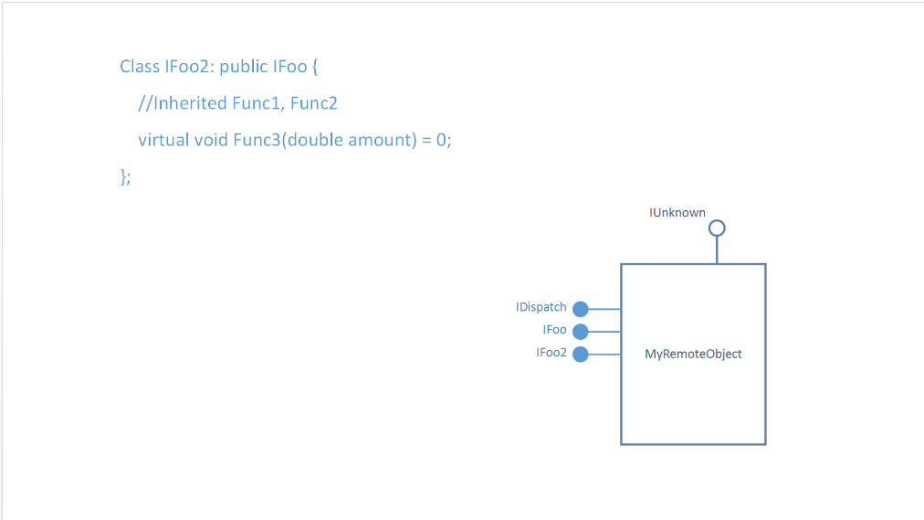
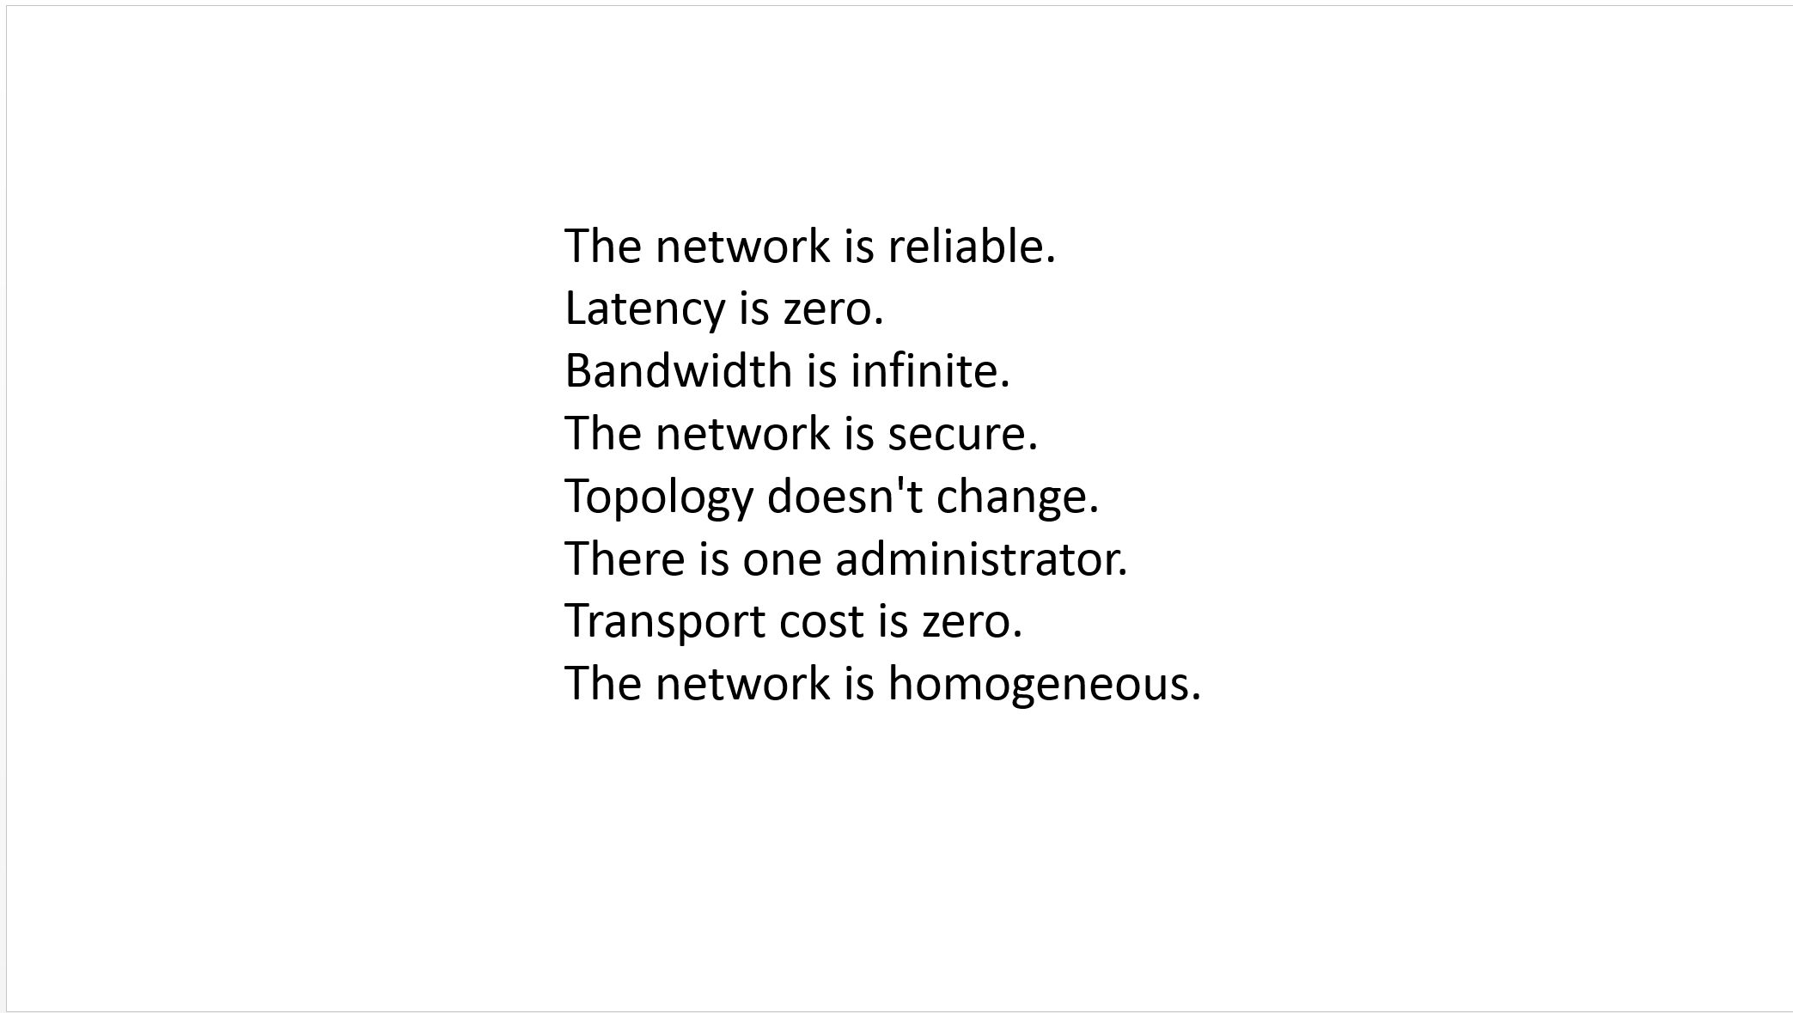
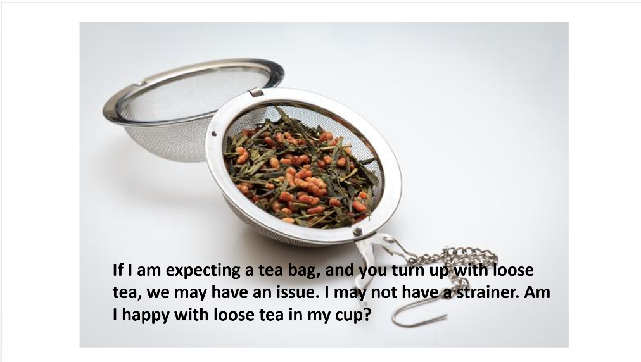
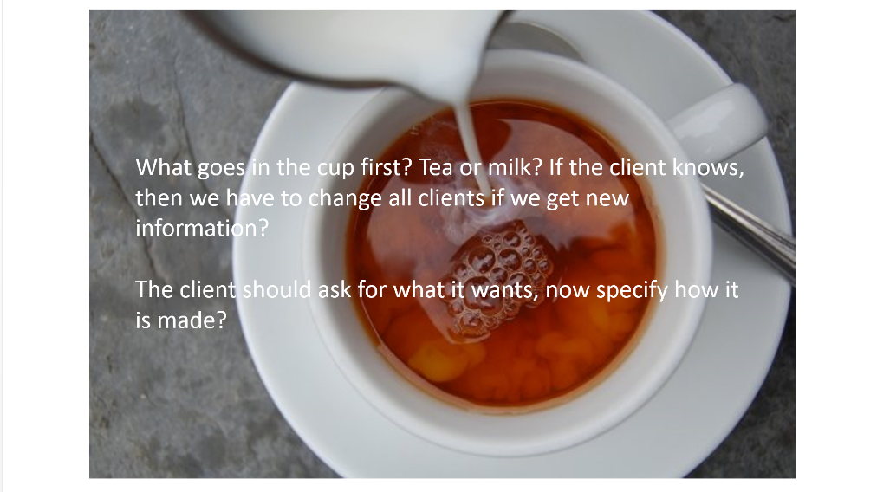

Slide 67

Q&A
Please vote when you leave, feedback is important

